Slide 1
Module 3 (Part I)
Design Patterns

Slide 2
Index
Basic concepts of Design patterns
How to select a design pattern
Creational patterns
Structural patterns
Behavioral patterns
Concept of Anti-patterns

Slide 3
Basic concepts of Design patterns
In software engineering, a design pattern is a general repeatable solution to a commonly occurring problem in software design
A design pattern isn’t a finished design
It is a description or template for how to solve a problem that can be used in many different situations
Patterns can be viewed as helping designers to make certain important design decisions.
At a basic level, patterns can also be viewed as well-documented and well thought-out building blocks for software design.

Slide 4
“Use a pattern million times over, without ever doing it the same way twice” by Christopher Alexander
Each design pattern systematically names, explains and evaluates an important and recurring design in object-oriented systems
Our goal is to capture design experience in a form that people can use effectively
To this end GoF Design Pattern documented some of the most important design patterns and present them as a catalog

Slide 5
GoF Design Patterns are divided into three categories:
Creational: The design patterns that deal with the creation of an object.
Structural: The design patterns in this category deals with the class structure such as Inheritance and Composition.
Behavioral: This type of design patterns provide solution for the better interaction between objects, how to provide loose coupling, and flexibility to extend easily in future.

Slide 6
In general, a pattern has four essential elements:
Pattern name
Problem
Solution
Consequences
Pattern name
Use to describe a design problem, its solutions, and consequences in a word or two
Naming a pattern immediately increases our design vocabulary
It makes it easier to think about designs and communicate to others
Finding good names has been one of the hardest part

Slide 7
Problem
Describes when to apply the pattern
It explains the problem and its context
Solution
The solution doesn't describe a particular concrete design or implementation
Because a pattern is like a template that can be applied in many different situations
Describes the elements that make up the design, their relationships, responsibilities, and collaborations
Consequences
They are the results and trade-offs of applying the pattern

Slide 8
How to select a design pattern
With more than 20 design patterns in the catalog to choose from, it might be hard to find the one that addresses a particular design problem, especially if the catalog is new and unfamiliar to you
Here are several different approaches to finding the design pattern that's right for your problem:

Slide 9
Consider how design patterns solve design problems
Find appropriate objects, determine object granularity, specify object interfaces, and several other ways in which design patterns solve design problems
Scan Intent sections
Read through each pattern's intent to find one or more that sound relevant to your problem
Study how patterns inter-relate
Studying these relationships between design patterns graphically can help direct you to the right pattern or group of patterns

Slide 10
Study patterns of like purpose
Study the similarities and differences between creational patterns, structural patterns and behavioral patterns
Examine a cause of redesign
Look at the patterns that help you avoid the causes of redesign
Eg : Algorithmic dependencies
Algorithms are often extended, optimized, and replaced during development and reuse
Objects that depend on an algorithm will have to change when the algorithm changes
Therefore algorithms that are likely to change should be isolated
Design patterns: Builder, Iterator, Strategy, Template, Method, Visitor

Slide 11
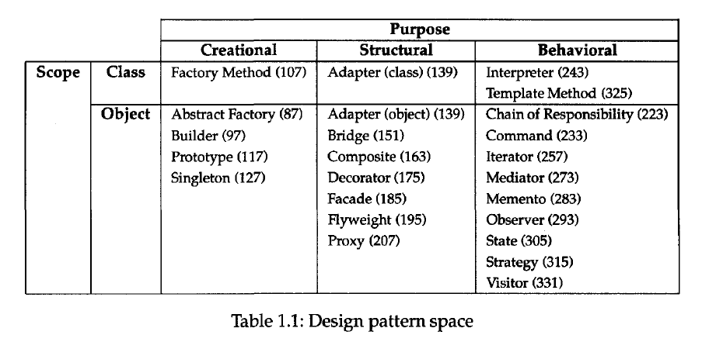
Organizing the Catalog
There are many design patterns, we need a way to organize them

Slide 12
Creational patterns are ones that create objects, rather than having to instantiate objects directly. This gives the program more flexibility in deciding which objects need to be created for a given case.
This pattern can be further divided into class-creation patterns and object-creational patterns
While class-creation patterns use inheritance effectively in the instantiation process
Object-creation patterns use delegation effectively to get the job done

Slide 13
Abstract factory groups object factories that have a common theme.
Builder constructs complex objects by separating construction and representation.
Factory method creates objects without specifying the exact class to create.
Prototype creates objects by cloning an existing object.
Singleton restricts object creation for a class to only one instance.

Slide 14
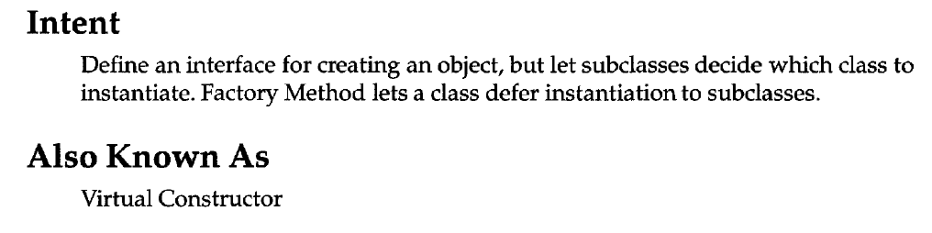
Factory Method
Class Creational

Slide 15
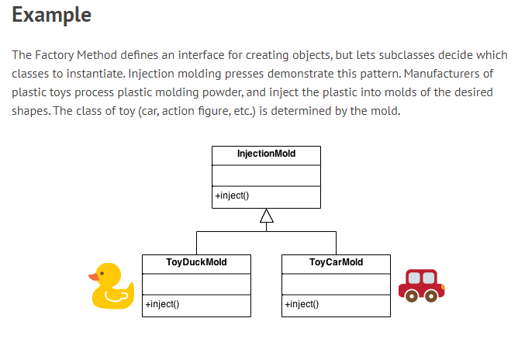

Slide 16
Structural patterns concern class and object composition. They use inheritance to compose interfaces and define ways to compose objects to obtain new functionality.
Adapter allows classes with incompatible interfaces to work together by wrapping its own interface around that of an already existing class.
Bridge decouples an abstraction from its implementation so that the two can vary independently.
Composite composes zero-or-more similar objects so that they can be manipulated as one object.
Decorator dynamically adds/overrides behavior in an existing method of an object.
Facade provides a simplified interface to a large body of code.
Flyweight reduces the cost of creating and manipulating a large number of similar objects.
Proxy provides a placeholder for another object to control access, reduce cost, and reduce complexity.

Slide 17
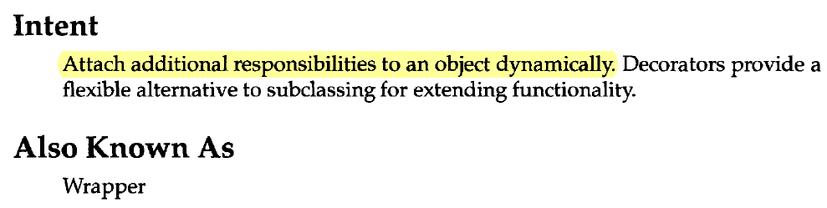
Decorator
Object Structural

Slide 18
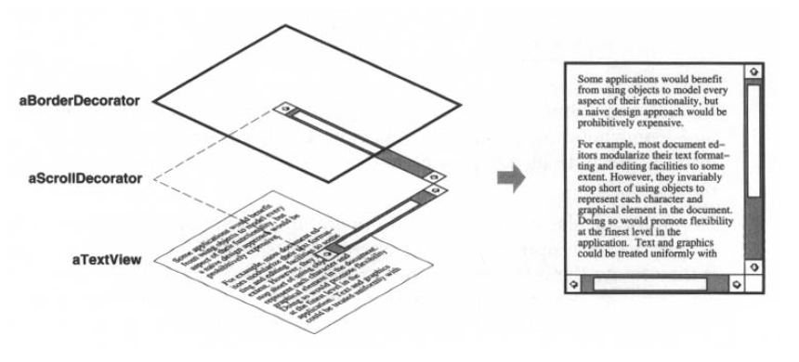

Slide 19
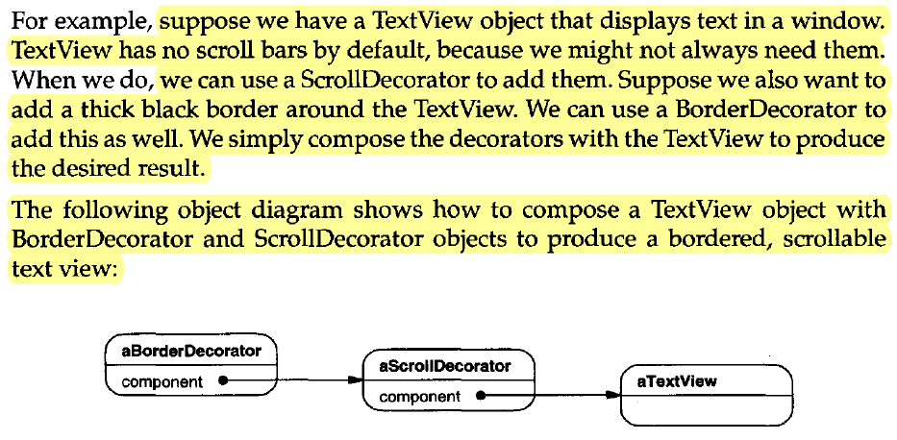

Slide 20
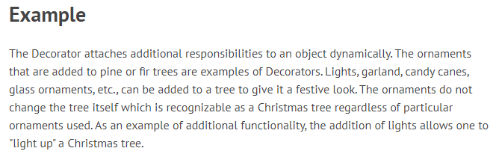

Slide 21
Behavioral Most behavioral design patterns are specifically concerned with communication between objects.
Chain of responsibility delegates commands to a chain of processing objects.
Command creates objects that encapsulate actions and parameters.
Interpreter implements a specialized language.
Iterator accesses the elements of an object sequentially without exposing its underlying representation.
Mediator allows loose coupling between classes by being the only class that has detailed knowledge of their methods.
Memento provides the ability to restore an object to its previous state (undo).
Observer is a publish/subscribe pattern, which allows a number of observer objects to see an event.
State allows an object to alter its behavior when its internal state changes.
Strategy allows one of a family of algorithms to be selected on-the-fly at runtime.
Template method defines the skeleton of an algorithm as an abstract class, allowing its subclasses to provide concrete behavior.
Visitor separates an algorithm from an object structure by moving the hierarchy of methods into one object.

Slide 22
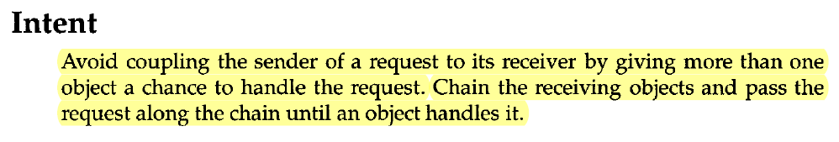
Chain of Responsibility
Object Behavioral

Slide 23
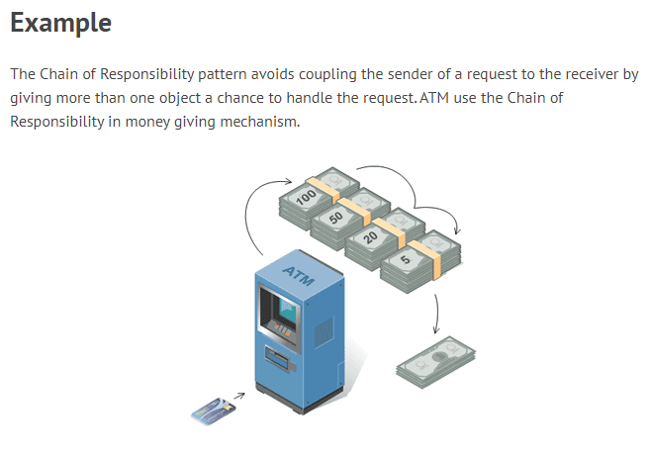

Slide 24
The following are the main pros strengths of design patterns:
Design patterns provide a common vocabulary that helps to improve communication among the developers.
Design patterns help to capture and disseminate expert knowledge.
Use of design patterns help designers to produce designs that are flexible, efficient, and easily maintainable.
Design patterns guide developers to arrive at correct design decisions and help them to improve the quality of their designs.
Design patterns reduce the number of design iterations, and help improve the designer productivity.

Slide 25
Important cons shortcomings of design patterns are the following:
Design patterns do not directly lead to code reuse. Since a design pattern is tailored for a specific circumstance of reuse, and therefore it is difficult to associate a fixed code segment with a pattern.
Design patterns provide general solutions, documented in a format that doesn't require specifics tied to a particular problem
At present no methodology is available that can be used to select the right design pattern at the right point during a design exercise.

Slide 26
Antipattern
If a pattern represents a best practice, then an antipattern represents lessons learned from a bad design.
The AntiPattern may be the result of a manager or developer not knowing any better, not having sufficient knowledge or experience in solving a particular type of problem, or having applied a perfectly good pattern in the wrong context
The following are two types of antipatterns that are popular:
Those that describe bad solutions to problems, thereby leading to bad situations.
Those that describe how to avoid bad solutions to problems.

Slide 27
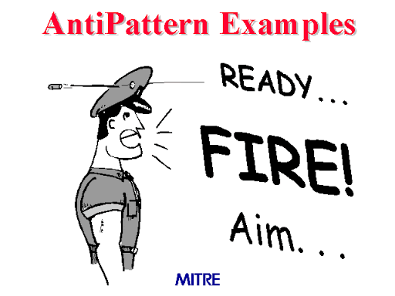

Slide 28
Antipattern
We mention here only a few interesting antipatterns without discussing them in detail.
Input kludge: This concerns failing to specify and implement a mechanism for handling invalid inputs.
Magic pushbutton: This concerns coding implementation logic directly within the code of the user interface, rather than performing them in separate classes.
Race hazard: This concerns failing to see the consequences of all the different ordering of events that might take place in practice.
A key goal of development AntiPatterns is to describe useful forms of software refactoring. Software refactoring is a form of code modification, used to improve the software structure in support of subsequent extension and long-term maintenance

